Slide 1


Convenção das Nações Unidas contra o Cybercrime;
Apresentação e ponto de situação da Convenção Contra
Crimes Cibernéticos da ONU
18 DE NOVEMBRO DE 2025
Notes:
The draft convention is a crucial response by Member States to the challenges faced by law enforcement agencies in their fight against cybercrime. These challenges are not new:
From a technical perspective, virtual space has become a major hub for criminal operations, with projected annual global costs reaching 10 trillion USD by 2025. Cyber-criminals exploit this virtual space, operating remotely and anonymously through tools like VPNs, encryption, and botnets.
On the legal level, law enforcement authorities fight a crime that knows no borders while only being able to act within their State’s own territory. Their investigations depend on obtaining electronic evidence - which is nowadays implicated in virtually any criminal case, scattered across multiple jurisdictions and inherently vulnerable to loss or manipulation.
Putting this more plainly, the international community has to combat the proliferation of cybercrime in a paradigm where “criminals operate at the speed of money and law enforcement operates at the speed of law”.
This draft convention, as its title suggests, therefore establishes a comprehensive framework to combat crimes committed through Information and Communications Technology systems – which are defined as any electronic device capable of automatically processing electronic data, such as computers or smartphones. And, beyond cybercrime, it also creates new mechanisms for sharing electronic evidence for any serious crime.

Slide 2
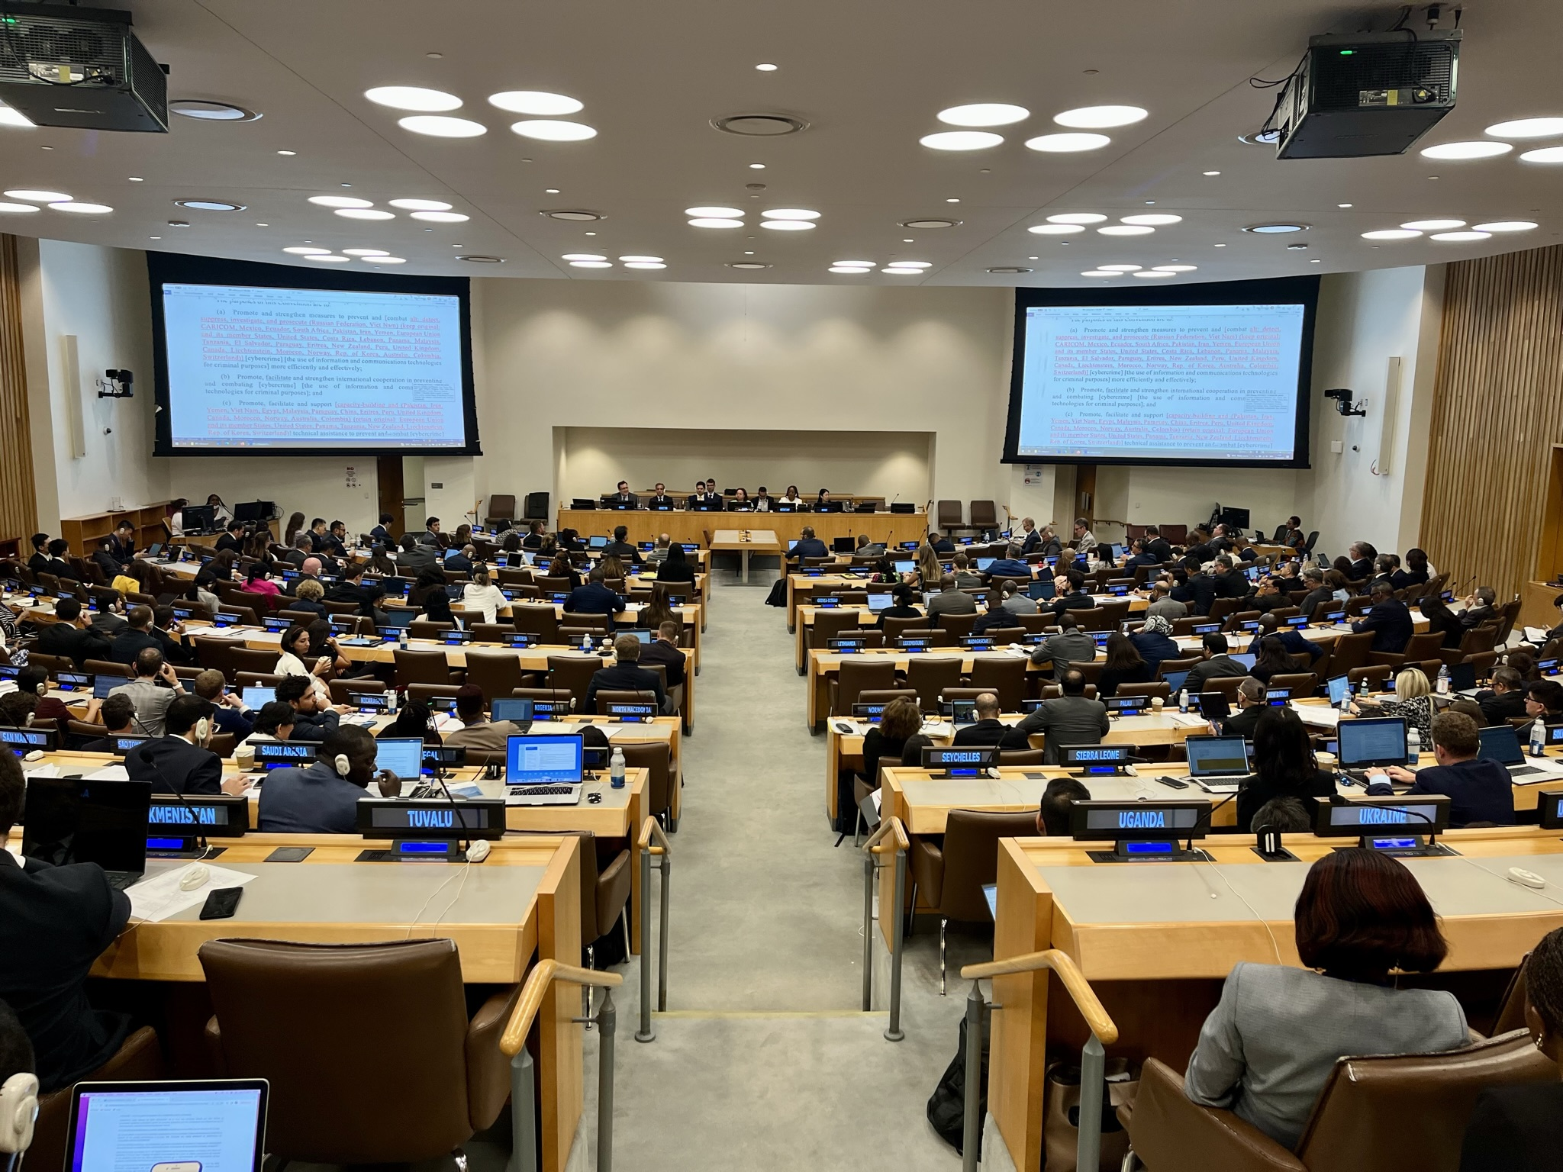
Contexto: O Comité Ad Hoc (2022-2024)
Mandatos: Resoluções da Assembleia Geral 74/247 and 75/282
Até 155 Estados participantes
Participação de Múltiplas Partes Interessadas
  21 ONGs, Órgãos e Agências da ONU
  70 ONGs com estatuto consultativo do ECOSOC
  69 outras organizações relevantes da sociedade civil, universidades e setor privado
  5 consultas interseccionais com múltiplas partes interessadas
Notes:
The AHC was established by GA res. 74/274 (27 Dec. 2019)
Its mandate was further defined by GA res. 75/282 (26 May 2021), including with regard to the holding of at least 6 sessions of 10 days each, and a concluding session, in both New York and Vienna + OP5 on decision-making + OP 9 on the participation of multi-stakeholders (more details below, if needed).
In addition, the road map and mode of work approved by the AHC at its first session further defined the work of the Committee.
Multi-stakeholder participation throughout the formal sessions:
21 Intergovernmental organizations and UN bodies and agencies
70 Non-governmental organizations (with ECOSOC consultative status)
69 Other relevant organizations → academia, private sector, other NGOs
Modalities for participation of multi-stakeholders: GA res. 75/282 and annex II of A/AC.291/6 as well as road map and mode of work
In the periods between the formal sessions, the AHC also held 5 intersessional consultations with multi-stakeholders.
The process was widely acknowledged as a new benchmark for inclusive treaty-making processes.

Slide 3
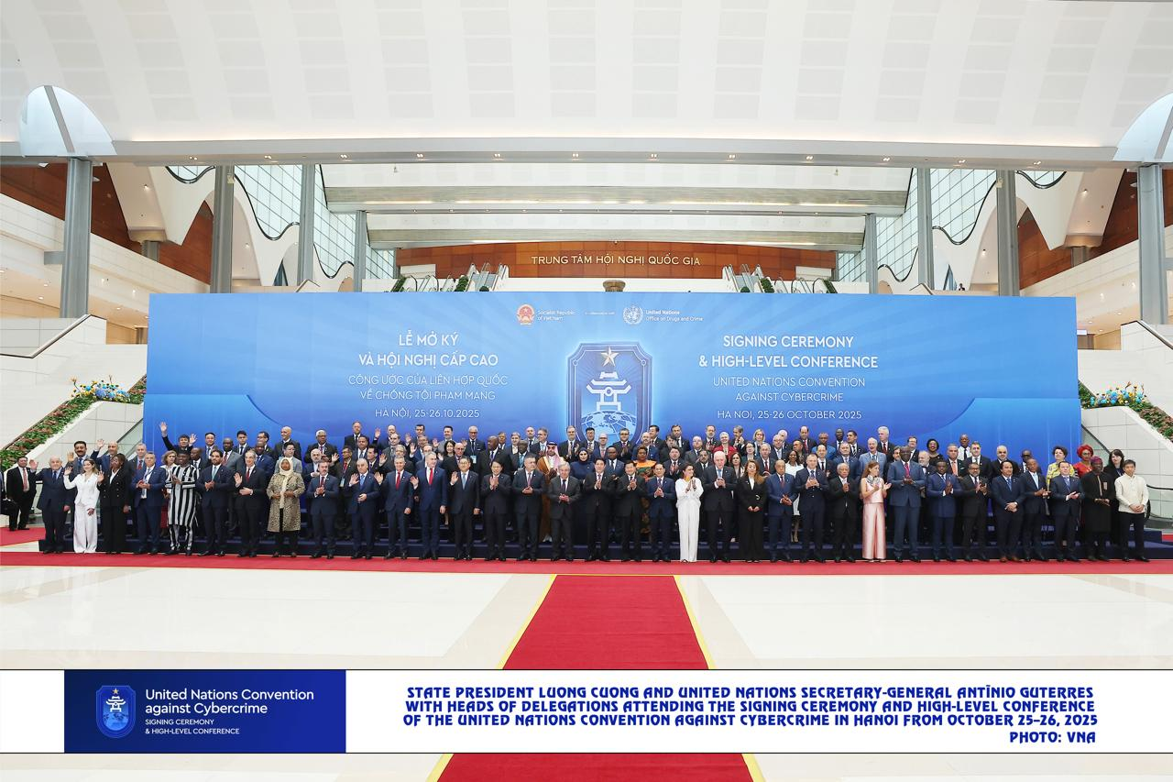
Assinatura da Convenção das Nações Unidas contra o Crime Cibernético – Hanói, Outubro 2025
Mais de 70 Estados assinaram no primeiro dia.
Estabelecer um instrumento jurídico multilateral para reforçar a cooperação internacional na prevenção e combate ao crime cibernético, incluindo troca de provas eletrônicas, criminalização de infrações digitais e fortalecimento das respostas nacionais.
O governo moçambicano assinou a convenção em Hanói no dia 25 de outubro de 2025, com uma delegação chefiada pelo Ministro do Interior, incluindo representantes do MINT, SERNIC, INTIC.
A adesão ao tratado permitirá ao país alinhar o seu quadro jurídico e institucional com padrões globais, melhorar a capacidade operacional de investigação de crimes informáticos, reforçar cooperação internacional.
Notes:
The AHC was established by GA res. 74/274 (27 Dec. 2019)
Its mandate was further defined by GA res. 75/282 (26 May 2021), including with regard to the holding of at least 6 sessions of 10 days each, and a concluding session, in both New York and Vienna + OP5 on decision-making + OP 9 on the participation of multi-stakeholders (more details below, if needed).
In addition, the road map and mode of work approved by the AHC at its first session further defined the work of the Committee.
Multi-stakeholder participation throughout the formal sessions:
21 Intergovernmental organizations and UN bodies and agencies
70 Non-governmental organizations (with ECOSOC consultative status)
69 Other relevant organizations → academia, private sector, other NGOs
Modalities for participation of multi-stakeholders: GA res. 75/282 and annex II of A/AC.291/6 as well as road map and mode of work
In the periods between the formal sessions, the AHC also held 5 intersessional consultations with multi-stakeholders.
The process was widely acknowledged as a new benchmark for inclusive treaty-making processes.

Slide 4
Os principais avanços jurídicos da convenção :
Criminalização
Medidas Processuais e Aplicação da Lei
Cooperação Internacional
Oportunidades de capacitação e desafios na implementação
Assistência Técnica e troca de informações
Desafios
Notes:
The draft Convention consists of 9 chapters, which work together to create a comprehensive framework against cybercrime.
Chapter 1 on general provisions establishes the fundamental rules and principles that govern the entire Convention, such as the respect for human rights and the protection of sovereignty.
Chapter 2 on criminalization establishes specific offenses committed through ICT systems and thus harmonizes criminal laws.
States parties are required to assert jurisdiction over these offences, especially when committed within their territory.
Chapter 4 on procedural measures and law enforcement adjusts traditional investigative methods to the ICT environment, empowering authorities to effectively counter cybercrime and collect electronic evidence for any crime.
These modernized procedures are “internationalized” in Chapter 5, on international cooperation, enabling the exchange of electronic evidence between States and other forms of international cooperation.
Under the chapter on preventive measures, States are required to address the root causes of cybercrime before harm occurs.
The chapter on technical assistance and information exchange strengthens worldwide capabilities to prevent and combat cybercrime through the sharing of expertise, resources and best practices, with particular attention to the needs of developing countries.
The chapter on the mechanism of implementation establishes a Conference of States Parties to the Convention to continuously review and improve its implementation.
Finally, the chapter on final provisions

Slide 5
Disposições Gerais
Estabelece as Regras Fundamentais da Convenção
  Finalidade (art. 1)
  Termos utilizados (art. 2)
  Âmbito de aplicação (art. 3)
  Proibição de crimes offline cometidos online (art. 4)
  Proteção de soberania (art. 5)
  Respeito dos Direitos Humanos (art. 6)
Artigo 2
(a) “Sistema TIC” – qualquer dispositivo electrónico capaz de processar automaticamente dados electrónicos (ex. computadores ou smartphones)
Artigo 2
(b) “Dados electrónicos” – informações digitais processáveis por sistemas TIC
Notes:
The chapter on general provisions is the foundation of the Convention and provides the basis for a comprehensive response to cybercrime. It proclaims the purpose of the Convention, establishes common terminology, and sets out the scope and basic rules applicable to the Convention as a whole.
Importantly, article 2 defines key terms to provide a common understanding of the Convention's technical terms and clearly delineate the scope of each provision. As it deals with cybercrime, the definitions of “Information and communications technology system” and “Electronic data” are particularly important.
(a) ”ICT-system” means any electronic device that is capable of automatically processing electronic data, such as computers or smart phones.
(b) “Electronic data” means digital information that can be processed by ICT systems. This includes “content data”, which is the substance of a digital communication (e.g. images, videos or text messages), and “traffic data”, which is the technical information generated by digital communications (e.g. origin, size, timestamps, and other metadata of the communication).
Article 4

Slide 6
Âmbito da Convenção
Provas Electrónicas
Medidas processuais internas | Preservação Recolha Obtenção | Qualquer Infração
Cooperação Internacional | + Partilha | Infrações previstas na Convenção
 |  | Crimes Graves
Infrações previstas na Convenção
(arts. 7-17)
Investigação e ação Penal
Prevenção
Arresto, Apreensão, Confisco, Restituição dos produtos do crime (bens ilícitos)
Notes:
The scope of the Convention delimits what States parties are required to do. It has two prongs:
The first prong relates to the Convention offences established under articles 7 to 17. It requires States parties to incorporate the offences set forth in articles 7 to 17 into their domestic criminal laws, enforce these laws by investigating and prosecuting these offences, and take preventive measures to address their root causes. Parties must also freeze, seize and confiscate the proceeds of these crimes and return it to their rightful owners.
The second prong relates electronic evidence. States parties are required to establish procedural measures at the domestic level that empower their authorities to collect, obtain and preserve electronic evidence for any criminal offence under domestic law (article 23). This ensures the admissibility of electronic evidence before courts of law and establishes the technical capabilities that facilitate international cooperation.
Moreover, at the international cooperation level, States parties also commit to help other states to preserve, collect and obtain electronic evidence located within their territory, and thus to share such evidence for both the Convention offences and for any serious crime (article 35).
The scope on electronic evidence thus extends beyond the Convention offences to include serious crimes, establishing the Convention as a complementary instrument to other United Nations criminal justice instruments. This enables the exchange of evidence for serious crimes, including those linked to terrorism or transnational organized crime, such as trafficking in persons, the smuggling of migrants, the illicit manufacturing of and trafficking in firearms, drug trafficking and trafficking in cultural property.

Slide 7
Crime Grave
“Conduta que constitua uma infração punível com pena privativa de liberdade de, pelo menos, quatro anos, ou com sanção mais grave”
(art. 2(h))
A escolha das infrações é, em princípio, determinada pelo direito interno
Exceto no exercício dos direitos humanos, incluindo a liberdade de expressão, de consciência, de opinião, de religião ou crença, de reunião pacífica e de associação
(art. 6.2)
Preâmbulo 3. […] incluindo terrorismo e crime organizado transnacional, como
Tráfico de seres Humanos,
Tráfico de migrantes,
Fabrico ilícito e tráfico de armas de fogo
Tráfico de droga,
Tráfico de propriedade cultural

Slide 8
Criminalização
Requer a criminalização de atos específicos, cometidos intencionalmente
Art. 7. Acesso ilegal | Crimes Ciber-dependentes
Art. 8. Intercepção ilegal
Art. 9. Interferência em dados electrónicos
Art. 10. Interferência num Sistema TIC
Art. 11. Utilização indevida de dispositivos
Art. 12. Falsificação relacionada com sistemas TIC | Crimes cibernéticos potencializados pela tecnologia
Art. 13. Fraude ou roubo relacionados com sistemas TIC
Art. 14. Infrações relacionadas com material de abuso ou exploração sexual de crianças online
Art. 15. Aliciamento ou manipulação com vista à prática de infração sexual contra crianças
Art. 16. Divulgação não consentida de imagens íntimas
Art. 17. Branqueamento dos produtos do crime
Notes:
In relation to the scope on preventing and combating the Convention offences, the chapter on criminalization establishes both cyber-dependent and cyber-enabled crime. States parties are required to establish these provisions as criminal offence under their domestic law, when committed intentionally.
In accordance with the draft resolution, through which the draft Convention will be adopted, the Ad Hoc Committee is also mandated to continue its work with a view to negotiating a draft protocol supplementary to the Convention, addressing, inter alia, additional criminal offences as appropriate. For that purpose the Ad Hoc Committee will reconvene 2 years after the adoption of the Convention for additional negotiating sessions, which could result in an additional protocol with additional crimes.

Slide 9
Medidas Processuais e Applicação da Lei
Estabelece os poderes investigativos no ambiente TIC
  Preservação e obtenção de provas electrónicas para investigação de toda a infração penal
Preservação acelerada de dados electrónicos armazenados (art. 25)
Preservação acelerada e divulgação parcial de dados de tráfego (art. 26)
Busca e apreensão de dados electrónicos armazenados (art. 28)
Coleta em tempo real de dados de tráfego (art. 29)
Interceção de dados de conteúdo (art. 30)
Ordem de entrega de documentos/dados (art. 27)
Medidas provisórias
Aquisição de dados armazenados
Aquisição de dados em trânsito

Slide 10
Cooperação Internacional
Medidas processuais “internacionalizadas” para cooperação em provas eletrónicas.
Cooperação internacional com o objetivo de preservação acelerada de dados eletrônicos armazenados (art. 42)
Cooperação internacional com o objetivo de divulgação acelerada de dados de tráfego preservados (art. 43)
Assistência jurídica mútua no acesso a dados eletrônicos armazenados (art. 44)
Assistência jurídica mútua na coleta em tempo real de dados de tráfego (art. 45)
Assistência jurídica mútua na interceção de dados de conteúdo (art. 46)
Medidas provisórias
Aquisição de dados armazenados
Aquisição de dados em trânsito

Slide 11
Cooperação Internacional
Outras Medidas de Cooperação
  24/7 Rede jurídica (art. 41)
Extradição (art. 37)
Transferência de pessoas condenadas (art. 38)
Transferência de processos criminais (art. 39)
Assistência jurídica mútua (art. 40)
Cooperação entre autoridades de aplicação da Lei (art. 47)
Recuperação de ativos (arts. 49-52)
Investigações conjuntas (art. 48)
Ponto focal para provas eletrónicas
Fornece/facilita:
    Orientação técnica
    Preservação de dados, incluindo informações do provedor de serviços para identificar sua localização
    Acesso de emergência a dados
Coordenação eficaz com autoridades de AJE/extradição
Notes:
In order to effectively counter these crimes, the chapter on procedural measures modernizes criminal investigation tools for the digital age, empowering domestic authorities to collect electronic evidence for any crime under domestic law.
These provisions equip law enforcement with the power to rapidly preserve stored electronic data through provisional measures to protect evidence from loss or manipulation; acquire stored data through production orders and search and seizure; and collect data as it moves across networks through interception and real-time collection.
Importantly, these investigative powers are carefully balanced with human rights protections, creating a framework that serves both domestic criminal justice needs and international cooperation.
Through these powers, competent authorities can effectively investigate and prosecute all convention offences domestically – and they can cooperate with other States in collecting, preserving and sharing electronic evidence, under the chapter on international cooperation.

Slide 12
Medidas Preventivas
As principais medidas preventivas incluem:
  Cooperação multissetorial
  Campanhas de consciencialização pública e educação
  Fortalecimento da capacidade da justiça criminal
  Programas de reintegração de cibercriminosos e desenvolvimento lícito de capacidades cibernéticas
  Proteção de grupos vulneráveis, com foco específico na segurança online de crianças e na violência de género
Desenvolver políticas coordenadas e boas práticas para reduzir as oportunidades de crimes cibernéticos por meio de medidas legislativas e administrativas
Participação ativa do setor não público (ONGs, academia, setor privado, sociedade civil) na prevenção
Assegurar o relato acessível de possíveis infrações
Manter os marcos legais atualizados em relação aos avanços

Slide 13
Oportunidades de capacitação
Assistência técnica e desenvolvimento de capacidades (art. 54)
Fornecimento de formação, especialização e transferência de tecnologia, com foco nas necessidades dos países em desenvolvimento
Cooperação multissetorial e Estatal
Intercâmbio de informações (art. 55)
Análise e partilha de desenvolvimentos legais/tecnológicos e boas práticas
Implementação da Convenção por meio do desenvolvimento económico e da assistência técnica (art. 56)
Cooperação ampliada via programas internacionais
Mecanismos de assistência financeira e material
Contribuições voluntárias regulares
Acordos bilaterais/multilaterais para apoio logístico

Slide 14
Desafios na implementação
A implementação da 24/7 Rede jurídica
Implementação international
Implementação nacional
A implementação das medidas Processuais
Análise jurídica
Implementação técnica das medidas de investigação

Slide 15
Contact:
Marie-Line BILLAUDAZ
Global Programme on Cybercrime – Africa Coordinator
marie-line.billaudaz@un.org

