Slide 1

Ghana’s Experience – Developing a Cybersecurity Framework
A National Journey Toward a Secure Digital Future
Presentation at Mozambique National Cybersecurity Awareness Week
17 – 21 November, 2025
Presented by
Eric Akumiah

Slide 2
Early Foundations (2010–2014)
2010 – Initial national discussions on cybersecurity – government, security agencies, business & not-for-profit
2011 – Gap analysis of ICT4AD led to the start of National Cybersecurity Policy & Strategy process
2012 – Establishment of NITA (gov)CERT support rollout of Government nationwide network Infrastructure – Fibre Optic, LTE, Data Centre , e-services etc
2014 – National CSIRT launched with ITU–IMPACT support

Slide 3
Policy & Strategy Evolution (2016–2024)
2016 – First National Cybersecurity Policy & Strategy approved.
2017 – Implementation begins with appointment of National Cybersecurity Advisor
2021–2024 – Review and update of the national strategy (approved 2024)
Approach:
Multi‑stakeholder, phased, nationally aligned

Slide 4
Policy & Strategy Pillars
First Policy & Strategy (2017- 2022)
Nine Pillars
  Effective Governance
  Legislative & Regulatory Framework
  Cyber Security Technology Framework
  Culture of security and Capacity Building
  Research & Development towards Self-Reliance
  Compliance and Enforcement
  Child Online Protection
  Cyber Security Emergency Readiness
  International Cooperation
Updated policy & Strategy (2024 – 2028)
Five Pillars
  1.Legal Measures
  2. Technical Measures
  3. Organisational Measures
  4. Capacity Building
  5. International & Local Cooperation

Slide 5
Evolution of coordination center
National Cyber Security Secretariat
Functional Secretariat for National Cybersecurity Advisor
National Cybersecurity Centre NCSC
- Prescribed by NCSPS
Cyber Security Authority
Prescribed by Cybersecurity Act

Slide 6
Evolution of Governance Framework
POLICY DIRECTION
TECHNICAL COORDINATION & ENGAGEMENT
OPERATIONS

Slide 7
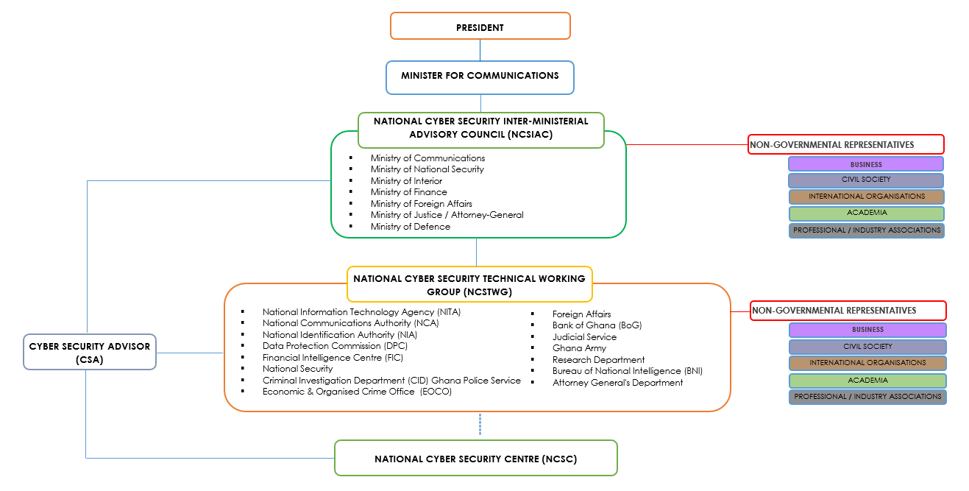
Governance Framework implemented under NCSPS
POLICY DIRECTION
TECHNICAL COORDINATION
& ENGAGEMENT
OPERATIONS

Slide 8
Governance Framework – UNDER ACT 1038
BOARD
JOINT CYBERSECURITY COMMITTEE
CYBER SECURITY AUTHORITY

Slide 9
CSIRT Ecosystem
National Communication Authority – All Licensed Public Network Operators
NCA
CERT
ICS
CERT
Industrial & Commercial Systems - Power & Water Systems Operators
National I.T Agency – All Government Networks & Systems
NITA
CERT
ARN
CERT
Academic & Research Networks – GARNET, GhREN & University & Research Institutions
National Security Council – All National Security Agencies
NSC
CERT
MIL
CERT
Military – All Arms of the Ghana Armed Forces & Regional Units
NATIONAL
CERT
Bank of Ghana – All Banking & Financial Institutions
BoG
CERT
BUS
CERT
Business or Private Sector – Any Private Sector Business That Require Incident Handling Services
New inclusion – Health Sector CSIRT

Slide 10
Legal & Regulatory Foundation – Cybersecurity Act, 2020 (Act 1038)
Established Cyber Security Authority (CSA)
Regulates cybersecurity activities nationwide
Mandates CII designation, protection & compliance
Introduces incident reporting and cybersecurity licensing
Creates National Cybersecurity Fund

Slide 11
Institutional Architecture
Cyber Security Authority – central regulator & coordinator
National CERT & sectoral CERTs (Banking, Telecom, Government etc.)
Sector regulators enforce domain‑specific cybersecurity requirements
Strong inter‑agency collaboration with LEAs & intelligence

Slide 12
Operational Mechanisms
Critical Information Infrastructure (CII) framework
Mandatory incident reporting & national response coordination
Licensing of cybersecurity professionals & service providers
National cybersecurity controls & baseline standards
Awareness creation & workforce development

Slide 13
Strengths of Ghana’s Model
Strong legal & regulatory foundation
Structured national strategy with clear pillars
Established CERT ecosystem
Active public‑private collaboration
Improving international rankings (GCI Tier 1)

Slide 14
Gaps & Improvement Opportunities
Uneven sector maturity
Need for enhanced threat‑intelligence sharing
Capacity limitations in specialized cybersecurity areas
Need for continuous national cybersecurity exercises

Slide 15

Ghana’s GCI positioning - 2024
Tier Status:
Tier 1, the highest status in the GCI's five-tier system, which designates a nation as a role model in cybersecurity practices.
Score:
Ghana achieved a score of 99.27%.
African Ranking:
This score places Ghana as the second-highest scoring country in Africa, just behind Mauritius.
Global Position:
Ghana is one of 46 countries worldwide and one of five in Africa to reach Tier 1 status.
Demonstrates strong policy, legal, and institutional maturity

Slide 16
Key Lessons from Ghana’s Experience
Frameworks must evolve with threats
Cybersecurity is a whole‑of‑nation effort
Legislation + institutions + capacity = sustainable resilience
Executive buy-in is key to developing a strong framework
Cybersecurity maturity requires continuous investment

Slide 17
Conclusion
Ghana provides a practical model for African cybersecurity development
CSA leadership and multisector collaboration critical
Future focus: innovation, intelligence sharing, and advanced capacity building

Slide 18
Reference
First Policy & Strategy
https://www.itu.int/en/ITU-D/Cybersecurity/Documents/Country_Profiles/National-Cyber-Security-Policy-Strategy-Revised_23_07_15.pdf
Updated Policy & Strategy
https://www.csa.gov.gh/resources/National%20Cybersecurity%20Policy%20and%20Strategy.pdf
Cybersecurity Act (ACT 1038)
https://www.csa.gov.gh/resources/cybersecurity_Act_2020(Act_1038).pdf
Critical Information Infrastructure Directive
https://www.csa.gov.gh/resources/Directive_CII.pdf

Slide 19
THANK YOU!
eric@first.org
+233-243380612

