Slide 1

FIRST CSIRT SERVICE FRAMEWORK
TLP:CLEAR
Eric Akumiah & Lawrence Muchilwa,
FIRST Africa Regional Liaison

Slide 2


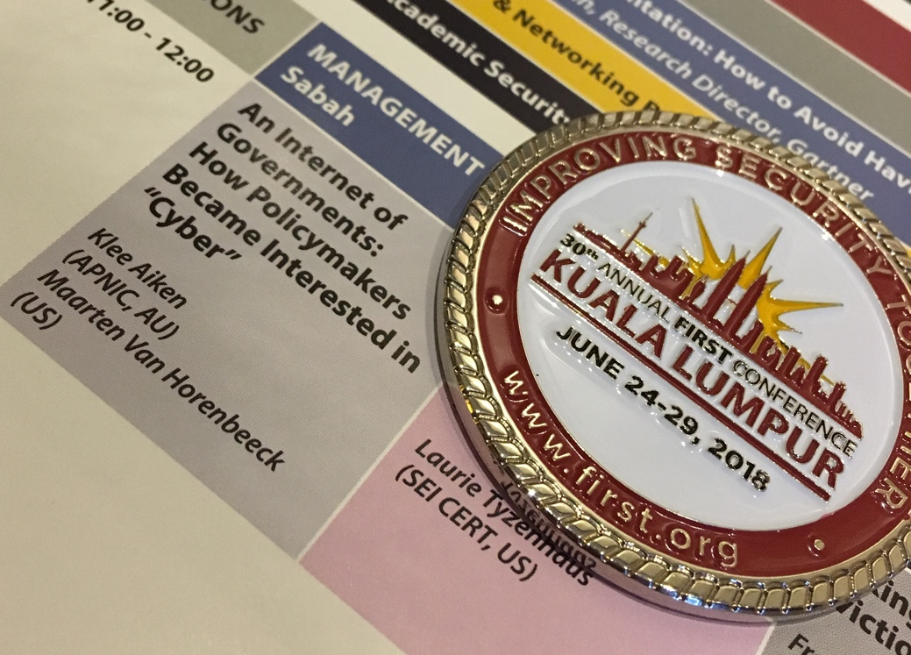
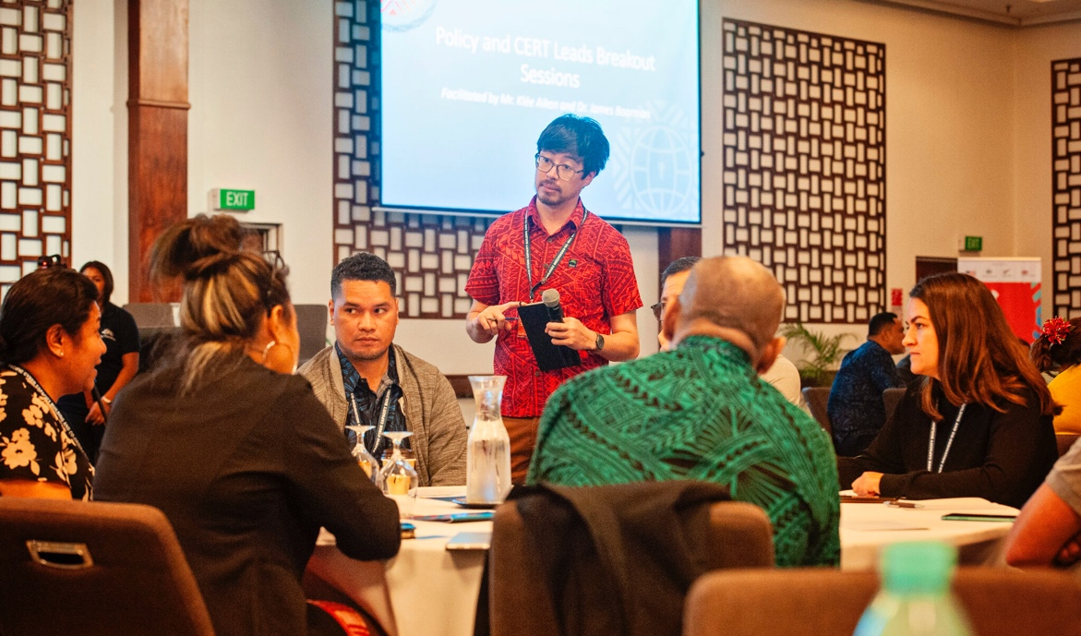
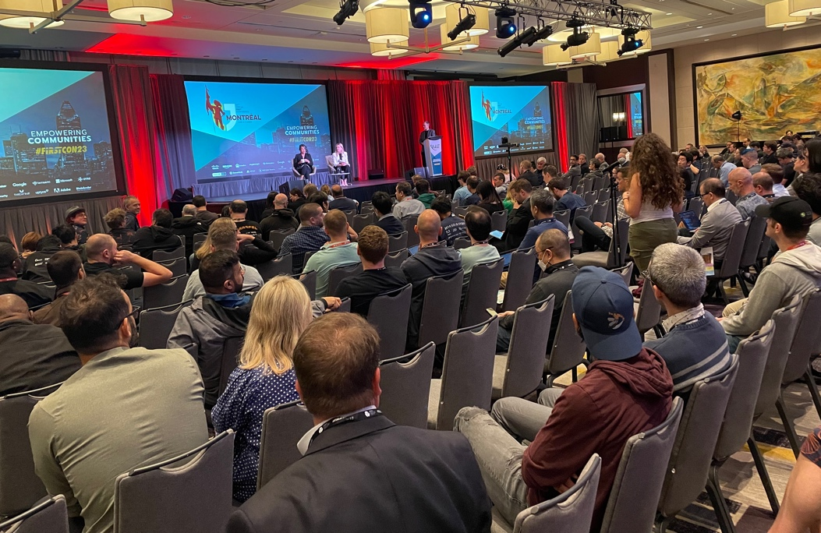

Forum of Incident Response & Security Teams
FIRST aspires to bring together incident response and security teams from every country across the world to ensure a safe internet for all.
https://www.first.org
Notes:
FIRST (Forum of Incident Response and Security Teams) is a non-profit membership community of incident response teams and practitioners.
The community includes 740+ teams from over 110 economies, with members from national teams, government, private sector, academia, civil society, and more.
A community of practitioners, FIRST aspires to bring together incident response and security teams from every country across the world to ensure a safe internet for all.
Together, FIRST and its community provide a trusted platform for information sharing, trust building, standards and good practice development, events, workshops, education, training
At the core of our work is operational incident response… and it is as a part of the incident response community that we work to strengthen global incident response capacity, together

Slide 3

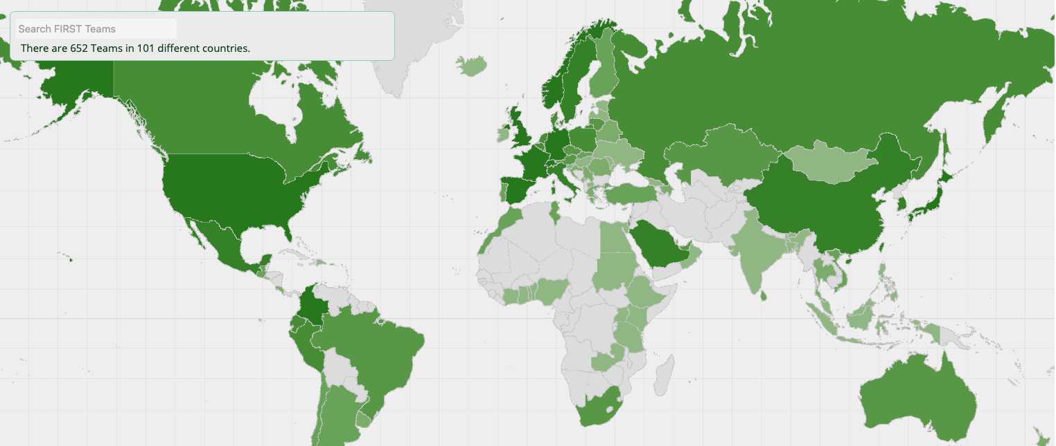
Who we are:
Global FIRST membership
    Global 819 teams in 113 countries – Africa 35 Teams

Slide 4
Who we are:
Premier non-profit global association of Incident Response and Security Teams
Founded in 1990
We enable incident responders
    To engage with their peers
    To have a shared understanding of security problems
    By developing technologies and standards
    By fostering an environment conducive to their work

Slide 5
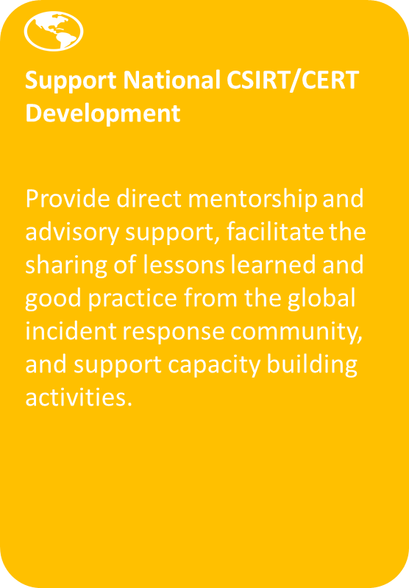
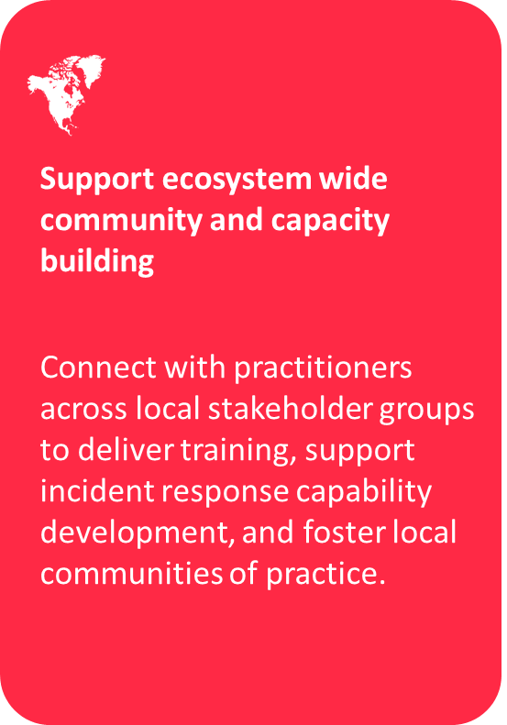
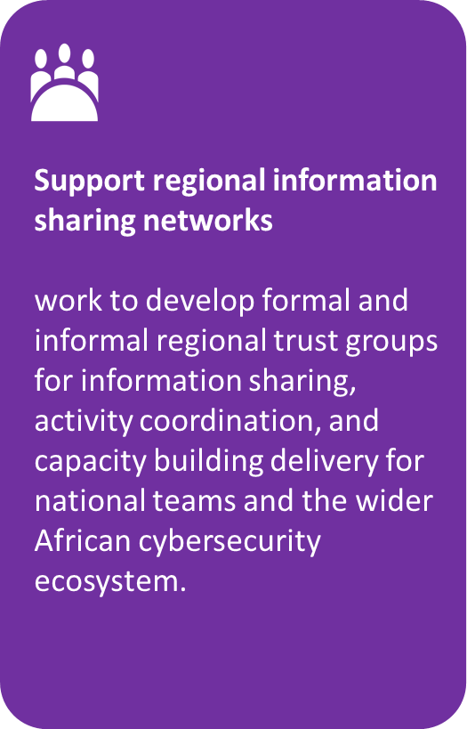
Focus Areas

Slide 6
FIRST Standards
TRAFFIC LIGHT PROTOCOL (TLP)
TRAFFIC LIGHT PROTOCOL (TLP)
Common Vulnerability Scoring System (CVSS)
Traffic Light Protocal
Service Frameworks
Information Exchange Policy (IEP)
Passive DNS Exchange
Exploit Prediction Scoring Systems (EPSS)
Vehicle of Development – Special Interest Groups (SIGs)

Slide 7
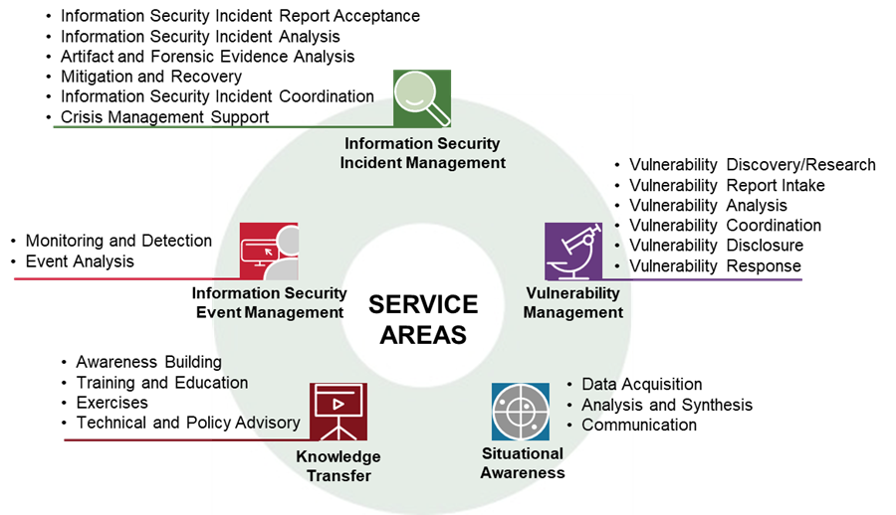
FIRST CSIRT SERVICE FRAMEWORK

Slide 8
Security Teams Type - by FIRST
Computer Security Incident Response Teams (CSIRT).
manage information security incidents by preventing, handling for a defined constituency
Information Sharing and Analysis Centres (ISAC)
industry-specific organizations or capabilities that gather, analyze, share, and coordinate information about cyber threats and incidents among critical infrastructures or industry sector entities (
Product Security Incident Response Team (PSIRT)
vulnerability management in products and services.
respond within vendor organizations or service providers to handle and resolve vulnerabilities in products or services.
Security Operation Centres (SOCs)
handle many different facets of security operations and focus on information security event management

Slide 9
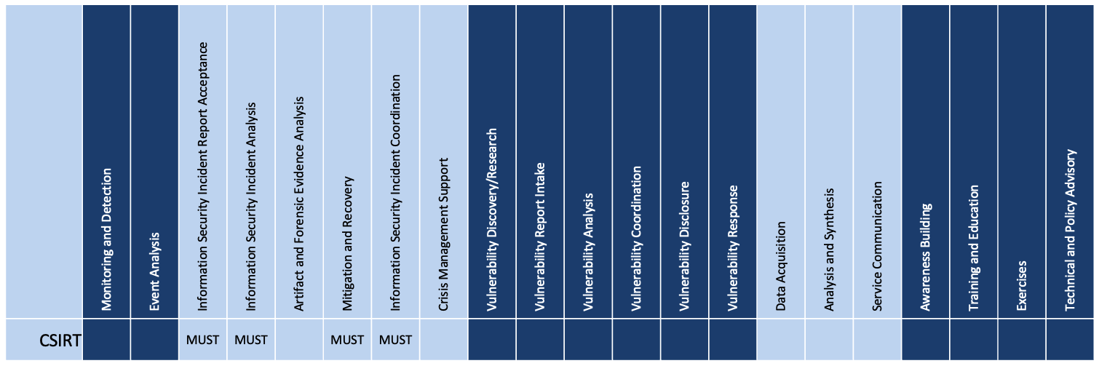
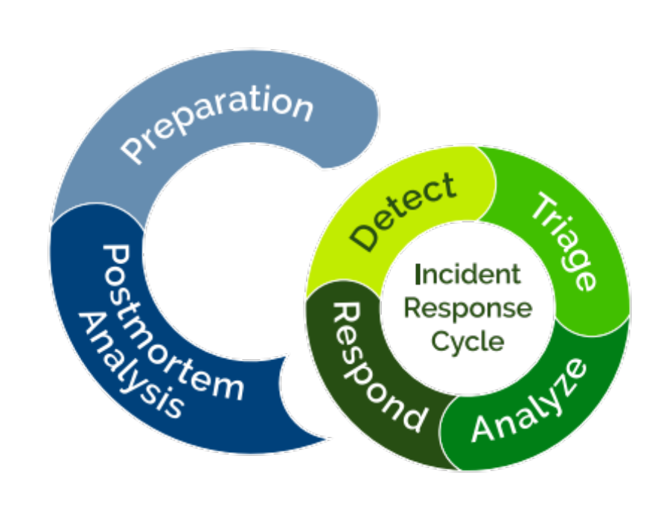
CSIRT Services - Adoption

Slide 10
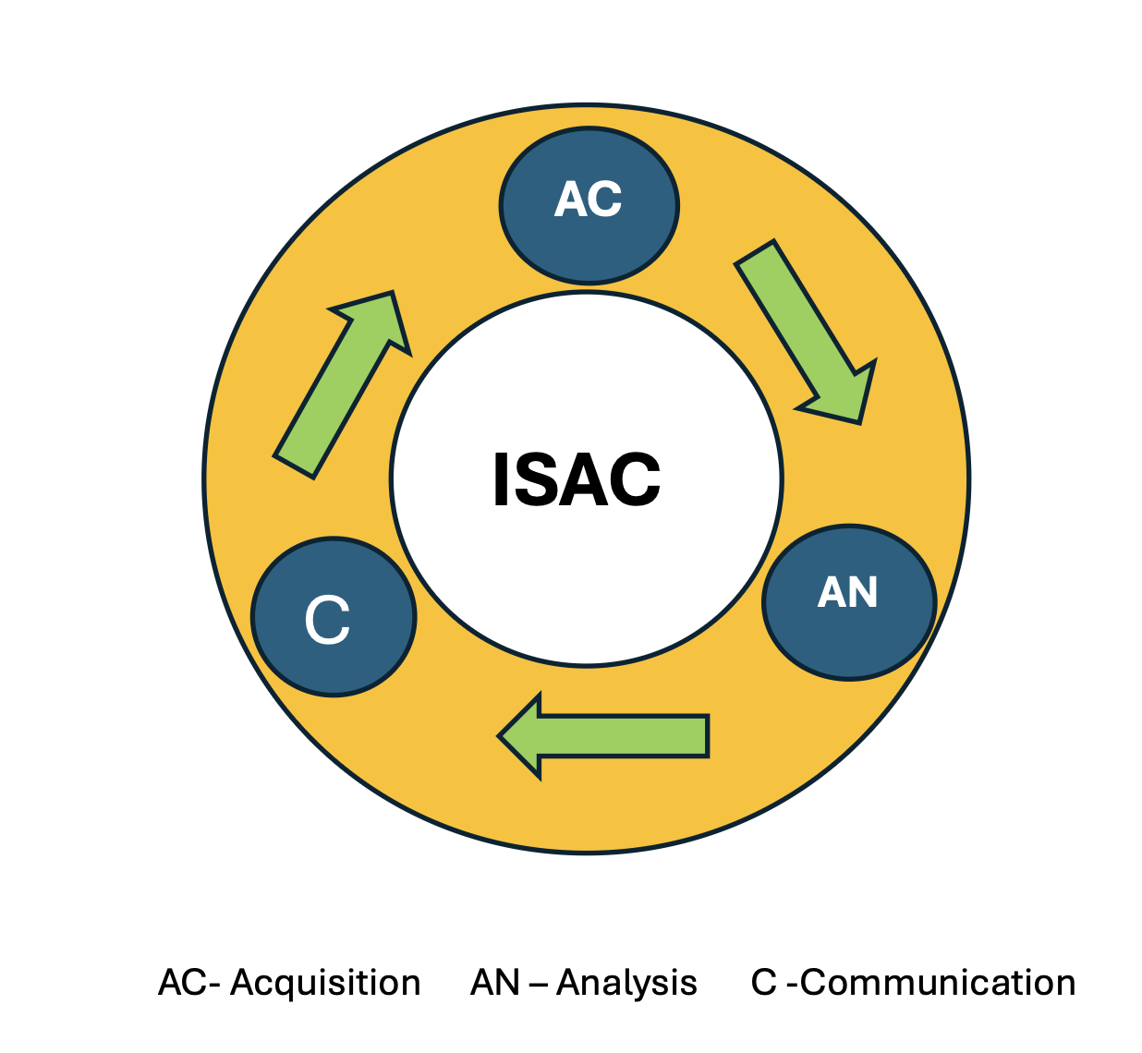
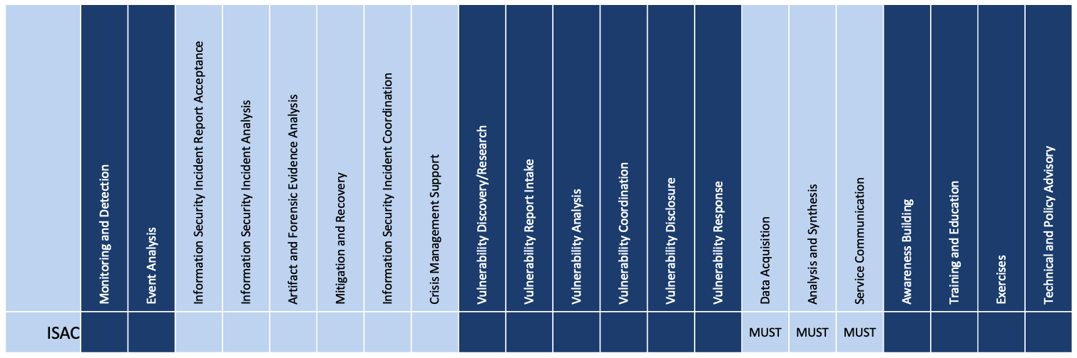
ISAC Service - Adoption

Slide 11
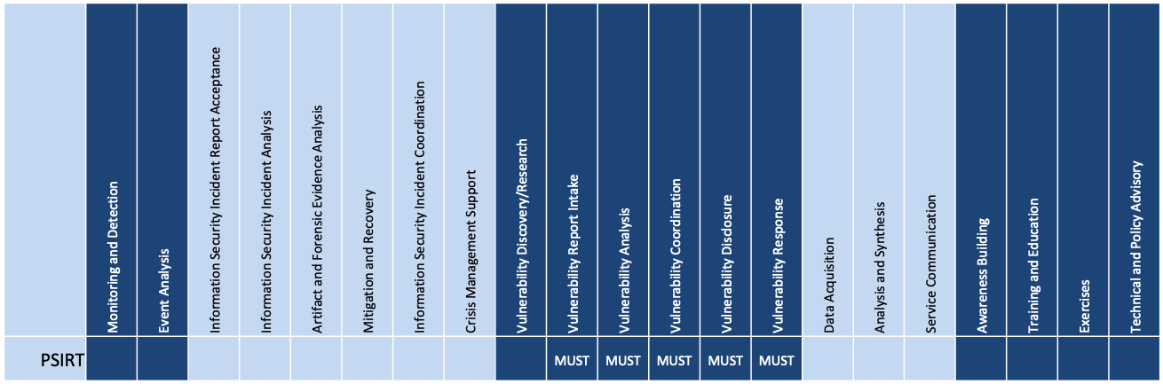
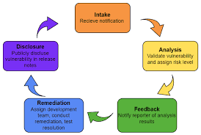
PSIRT
PSIRT Service - Adoption

Slide 12
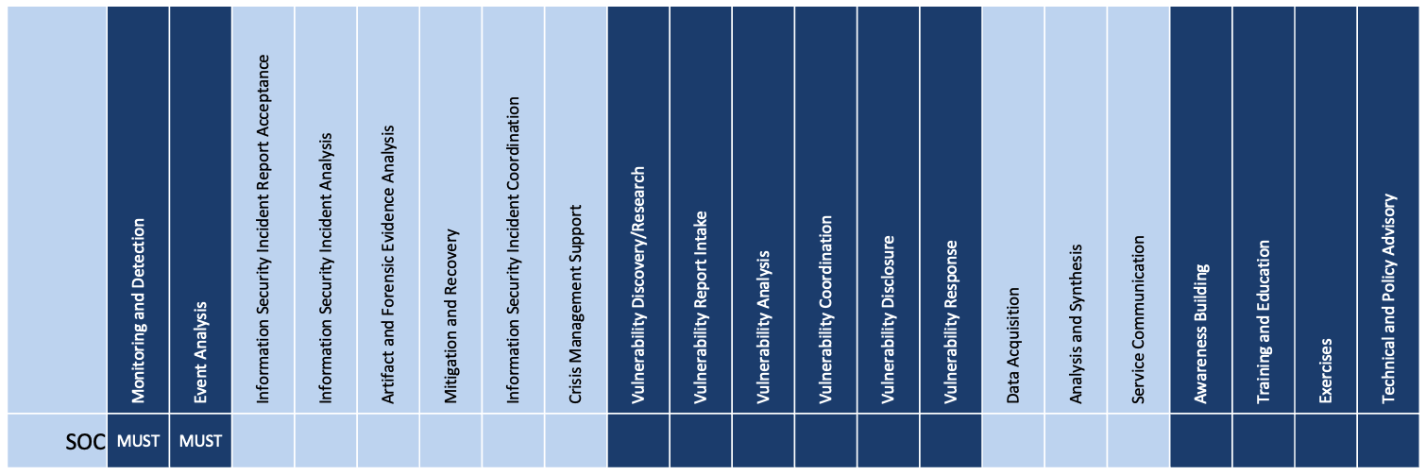
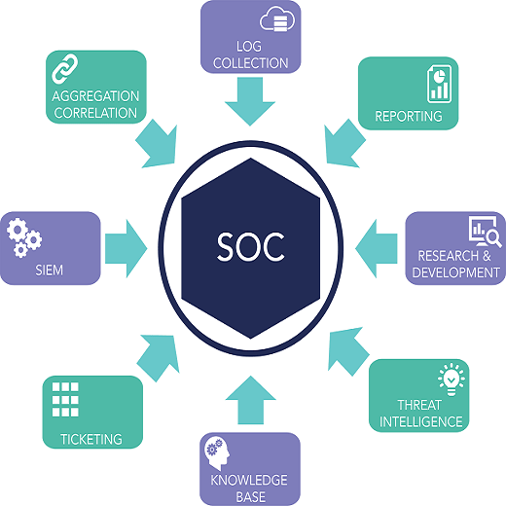
SOCs
SOC Services - Adoption

Slide 13
Defining CSIRT Services
Mandatory service required to be considered a CSIRT was the incident response service now referred to as incident handling
Provision of at least one of the incident handling services—incident analysis, incident response on site, incident response support, or incident response coordination—is still mandatory to be considered a CSIRT.

Slide 14
Roles
Example of Service Adoption
Information Security Incidnet report Accfeptance
Channels
- Email
-Text
- Phone
-WhatsApp
- IR Form on Website
Incident manager
1st level
Situational
awareness
2nd level
3rd level
Reporting & Supervision
Incident Reports
Threat intelligence
Duty officer
Incident handler
Technical task
Analyst
Incident
News
Incident handler
Analyst
Tools : - Request Tracker Incident Response (RTIR)
Notes:
We are discussing various roles from the perspective of incident management processes, not the team structure in an organisation. A role is a set of tasks and responsibilities, not a position in the organisation. In smaller teams it is perfectly fine to assign more than one role to a single person. As the team grows, you can think of addressing individual roles, taking into account the required skills.
The role of incident manager is to coordinate handling of the incidents, take strategic decisions, interface between the handlers (and the rest of the team) and the higher management, as well as PR, communication etc. He/she is also responsible for the level of preparedness and resilience of the team: tooling, staffing, support for off-site operations, food for over-the-clock activities…
The role of a duty officer is to collect all incoming information, digest them and make sure they are acted upon. Detected incidents need to be assigned to incident handlers, while other information (open/closed source news, reports, threat intel dashboards etc.) should be analysed and digested into situational awareness report. If resources permit, the role may be split into two roles which require different sets of skills: e.g. triage officer and situational awareness analyst.
An Incident handler (also called incident lead) is responsible for incidents that are assigned to him. He will assign tasks to analysts, build and verify hypothesis, communicate with constituency and other parties at operational level. He will report on the progress of investigation and escalate or resolve the incident.
An Analyst will perform technical tasks, such as forensics, reverse engineering, vulnerability testing etc.

Slide 15
EG: Service Adoption National CSIRT
Authority : No authority on Networks
Coordinating function
Support teams to handle Incidents
Constituency: Public, sector CSIRTs
Initial Service Adopt
1. Information Security Incidnet Report acceptance
2. Information Security Incident Coordination
3. Information Security Incident Analysis
4. Migitgation and Recovery
Next add:
ISAC Service
TOOLS : RTIR + MISP

Slide 16
EG: Service Adoption for Government CSIRTs
Authority: Authority over Government Network
Coordinating function
Support teams to handle Incidents
Constituency: Government Agencies
Initial Service Adopt
1. Information Security Incidnet Report acceptance
2. Information Security Incident Coordination
3. Information Security Incident Analysis
4. Migitgation and Recovery
Next add:
SOC Service
TOOLS – RTIR + SIEM

Slide 17
Selecting Services using Risk Profile
Risk-based thinking ensures that resources target the most critical threats. It shifts organizations from reactive response to proactive risk mitigation.
CSIRT functions should match risk exposure. High-value systems require rapid detection and containment. Use a risk-tier matrix for prioritization.
A risk-based approach ensures CSIRT alignment with organizational priorities.
It transforms cybersecurity from a reactive defense to a strategic enabler.

Slide 18
Conclusion
Rule of Thumb – Start small and Add more Services as you grow.
More services mens more staff.
Services depend on mission and authority of the CSIRT.
Tools depend on services selected

Slide 19
Thank you
  eric@first.org
  Lawrence@first.org

