Slide 1


Capacity Development at ITU Building Skills for an Inclusive and Secure Digital Future.
November 2025

Slide 2
ITU and Cybersecurity: a Timeline
ITU Cybersecurity – Development Bureau
2010-2011
WTDC Res.67
CyberDrills &
CIRT establishment
2007
Global Cybersecurity Agenda
2018
NCS Guide
2003 - 2005
WSIS Action Line C5
1988
X.509
2022
Cyber for Good Project
1865
ITU
Established
2021
Women in Cyber
NCS Guide 2nd Edition
2002
WTDC
2014
First Global Cybersecurity Index
2006
WTDC Res 45
2008
Child Online Protection
Initiative l

Slide 3
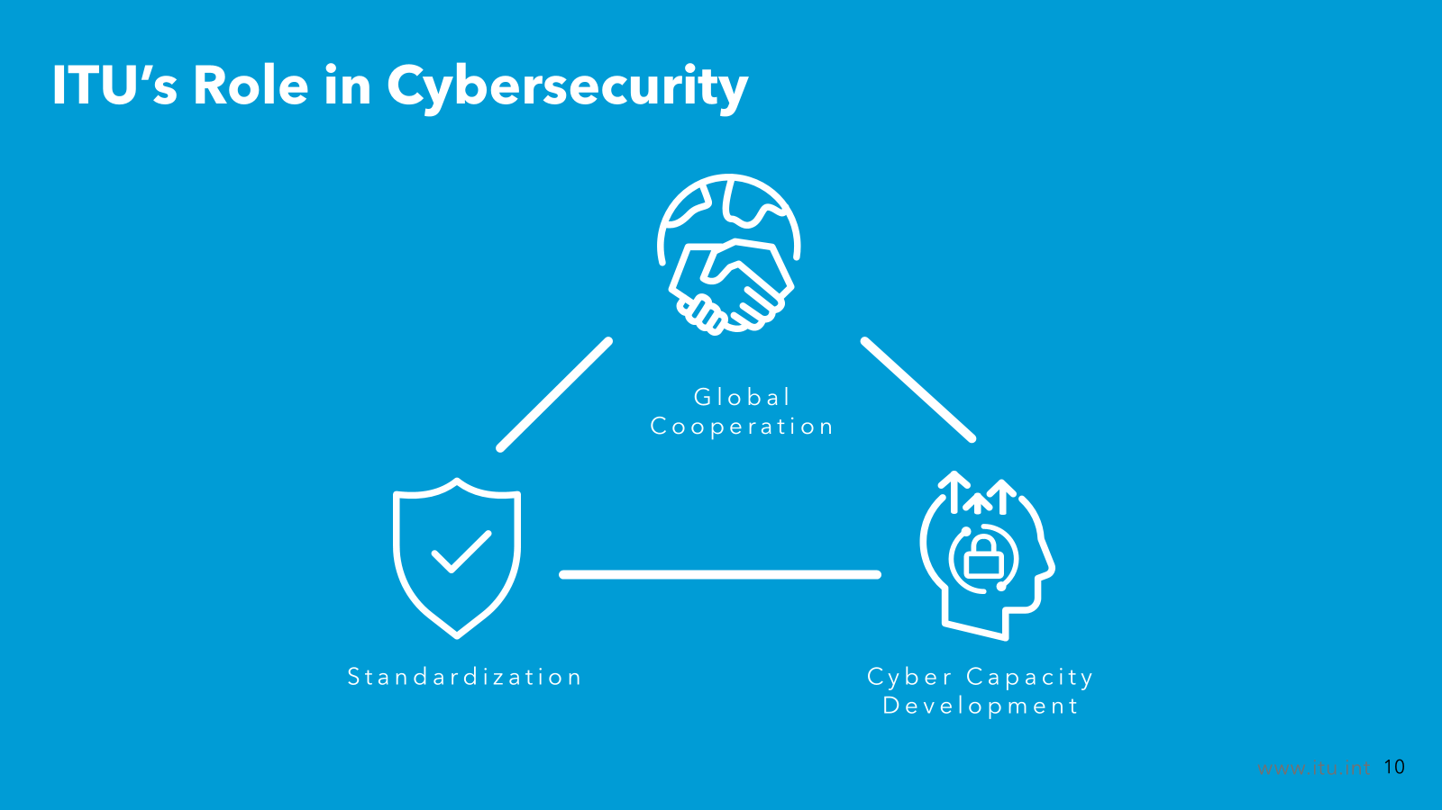
ITU’s Role in Cybersecurity
Global Cooperation
Standardization
Cyber Capacity Development

Slide 4
ITU Cybersecurity Development works across:
ITU Cybersecurity – Development Bureau
Areas of intervention
Data and Advocacy
Incident Response
Strategy and Policy
Skills Development
Online Safety
Selected means of developing impact
GCI
CIRTs
NCS & Action Plans
Women in Cybersecurity
Youth and Child Online Protection
Research
CyberDrills
Cybersecurity Governance
Youth for Cyber*
Online safety for vulnerable groups **
Partnerships and Collaboration
* Planed – NEW, Targeting youth
** Planed – NEW, Targeting persons with disabilities, elderly and women

Slide 5
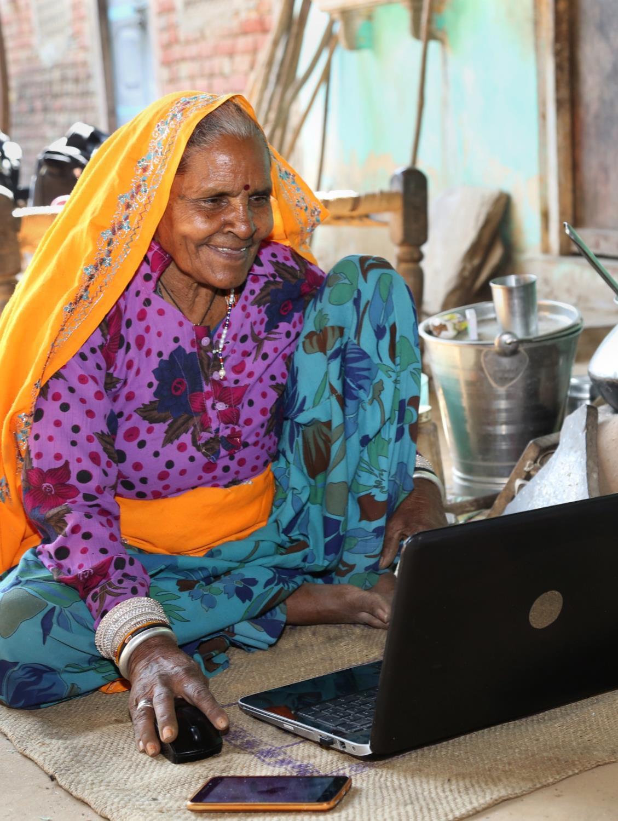
Skills for the digital transformation
Capacity development at ITU
The Telecommunication Development Sector (ITU-D) of the ITU works to close the digital divide and drive digital transformation to leverage the power of ICTs for economic prosperity, job creation, digital skills development, gender equality, diversity, a sustainable and circular economy, ​and for saving lives.
Its work prioritizes those most in need - from people living in the world’s Least Developed Countries to marginalized communities everywhere.

Slide 6
Capacity development at ITU
Our mission
What we do
The Capacity Development work aims at achieving a digitally competent society where all people use knowledge and skills on digital technologies to improve their livelihoods.
developing capacities of ICT professionals,
boosting digital literacy and skills of citizens,
and developing knowledge resources and tools for policy makers.

Slide 7
Why this programme?
A global challenge
Our solution
ICTs have become the foundation for every economic sector and a sine qua non of business performance and national growth.
The new digital world is calling on professionals in both the public and private sectors to drastically expand their knowledge and skills to unleash digital transformation.
Starting in 2023, the programme builds on ITU’s longstanding expertise in ICT capacity development and will succeed the Centres of Excellence programme.
Up to 16 ITU Academy Training Centres (ATCs) will be selected to deliver high-quality courses, mostly online, which address priority needs for capacity development in ITU Member States.

Slide 8
Focus on top priorities
How will the programme work?
Policy and regulation
Network infrastructure
Spectrum management
Cybersecurity
Digital inclusion
Digital services
The programme focuses on critical areas of digital development, and reflects the geographical diversity and requirements within the ITU membership.
Priority themes will be regularly assessed to meet the ever-evolving demands of the digital world.

Slide 9
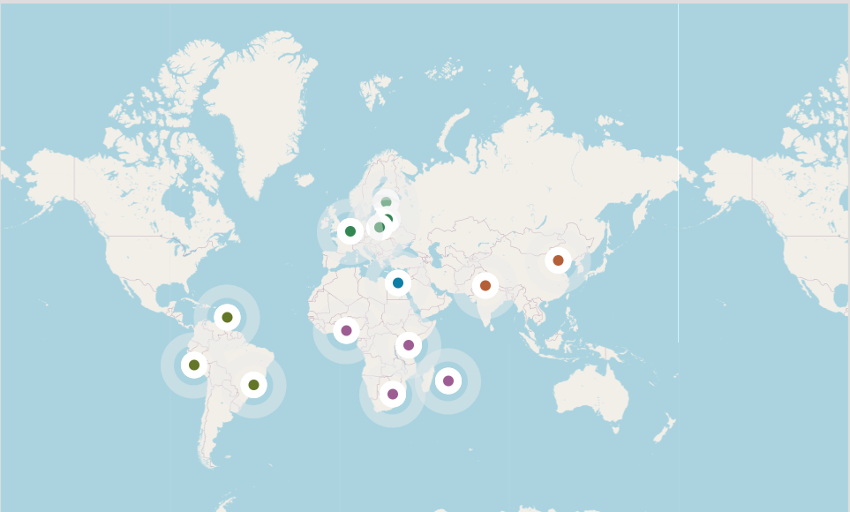
List of ATC by region
How will the programme work?
14
Africa
African Advanced Level Telecommunications Institute (AFRALTI)
Computer Emergency Response Team of Mauritius (CERT-MU)(CERT-MU)
Digital Bridge Institute(DBI)
University of the Witwatersand(WITS)
Arab States
Egyptian African Telecom Regulatory Training Center(EG-ATRC)
Asia & Pacific
China Academy of Information and Communications Technology(CAICT
National Communications Academy - Technology(NCA-T)
Europe
National Institute of Telecommunications(NIT)
NRD Cyber Security(NRDCS)
Tallinn University of Technology(TALTECH)
UNU-MERIT /Maastricht University(UNU-MERIT)
The Americas
Instituto Nacional de Investigación y Capacitación de Telecomunicaciones – Universidad Nacional de Ingeniería (INICTEL UNI)
Instituto Nacional de Telecomunicações(INATEL)
The University of the West Indies(UWI)

Slide 10
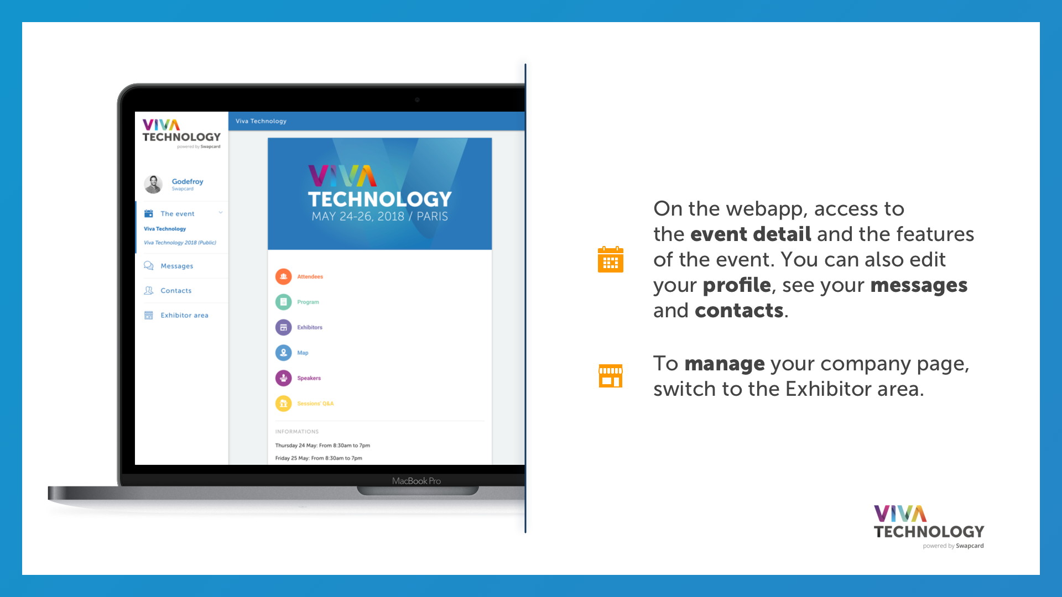
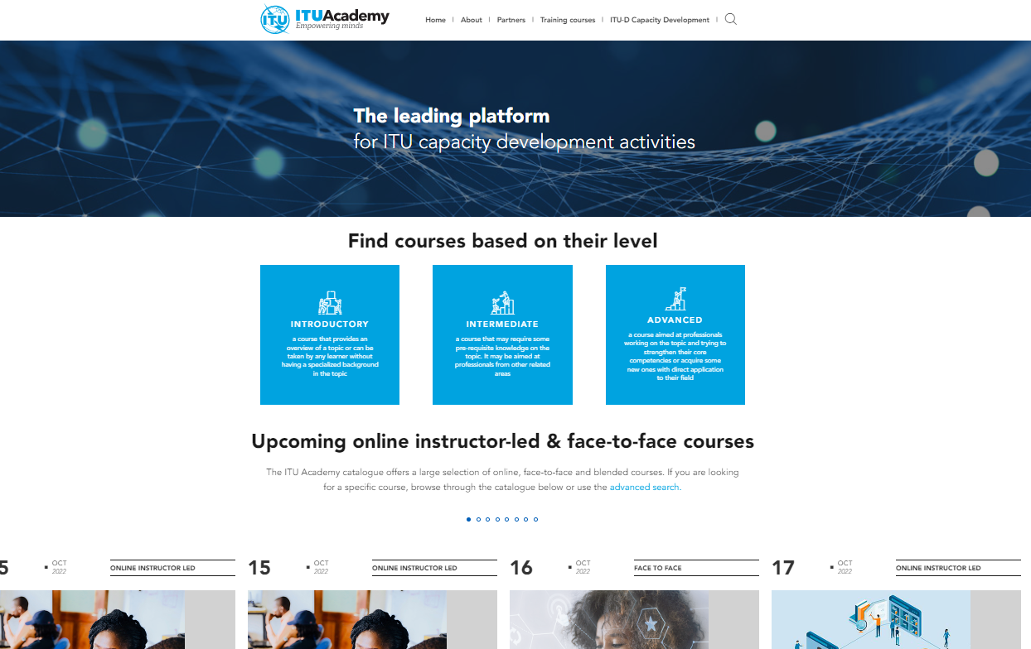
ITUAcademy: a world-class online learning platform
Capacity development at ITU
The ITU Academy is ITU’s online platform for learning and training in the field of digital development
150+ courses offered annually.
48’000+ ICT professionals and policymakers trained to fully participate in, and contribute to, the digital transformation, since 2018.
70% of participants are from developing countries
Training catalogue: https://academy.itu.int/training-courses/full-catalogue

Slide 11
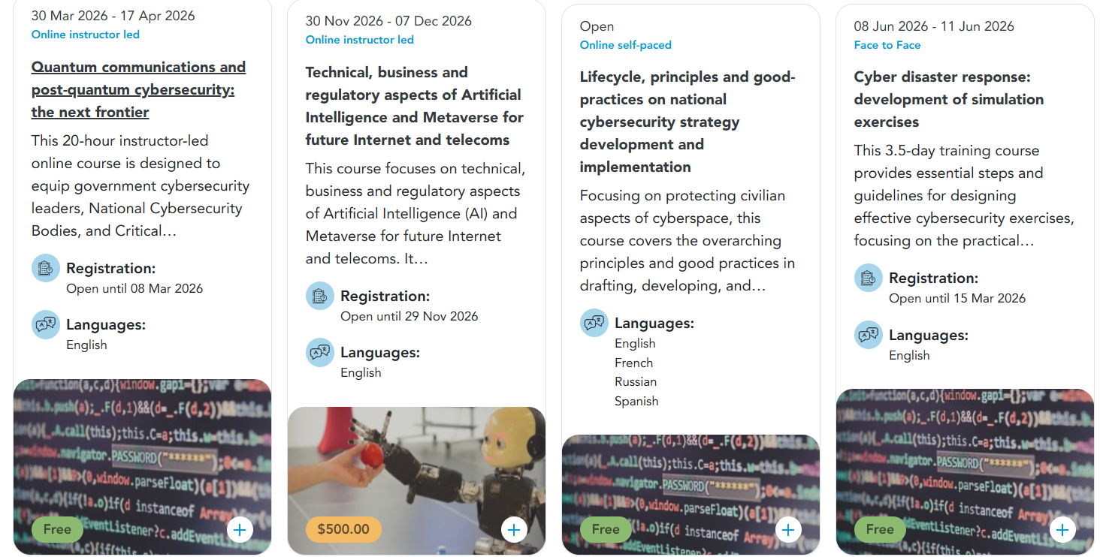
Capacity development at ITU

Slide 12
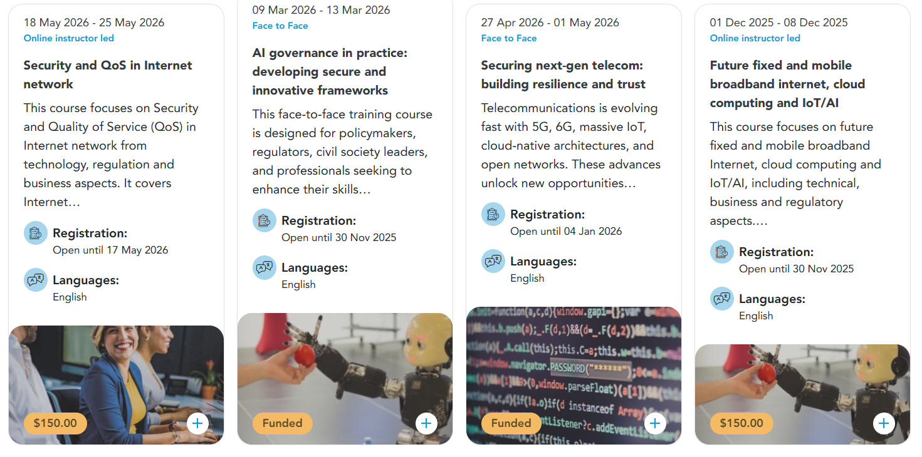
Capacity development at ITU

Slide 13
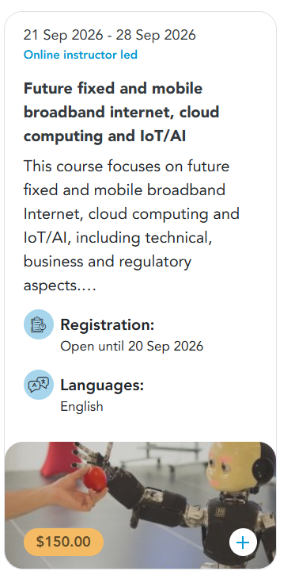
Capacity development at ITU

Slide 14


