Slide 1


Resilience to Africa's
Rising Cyber Threat
Analysis based on the Africa Organised Crime Index 2025

Slide 2

The Enforcement Challenge
States struggle to keep pace with sophisticated and rapidly evolving cyber threats

Slide 3
Key Capability Gaps
Lack of Technical Tools: Most law enforcement agencies lack advanced digital forensics laboratories and real-time network monitoring technologies.
Insecure Storage: A widespread lack of secure digital evidence storage systems hinders investigations and compromises evidence integrity.
Pacing & Asymmetry: Cybercriminals are adopting encryption and anonymisation software at a rate that outpaces the capabilities of most national systems.
Transnational Networks: These gaps leave the continent increasingly exposed to sophisticated, transnational cybercriminal networks.

Slide 4
The Widening Gap
-0.41
An Asymmetric Fight
This asymmetry between state capabilities and the sophisticated digital tools used by criminals risks widening the enforcement gap even further.
Decline in average 'law enforcement' score since 2019.
The 2025 Index reflects this decline, showing that despite some progress, enforcement capacity is struggling to keep up with the accelerating threat.

Slide 5





Barriers to Cooperation
Cross-Border Problem
Lack of Interoperability
Foreign-Based Evidence
Fragmented legislation and differing legal systems hinder efforts to pursue perpetrators beyond national borders.
A lack of interoperability between national systems stalls data sharing and makes joint investigations slow and inconclusive.
Limited access to digital evidence from foreign-based platforms is a major roadblock, leaving many investigations stalled.

Slide 6
Snapshot: Crime Index 2025
A look at cyber-dependent crime scores across the continent

Slide 7
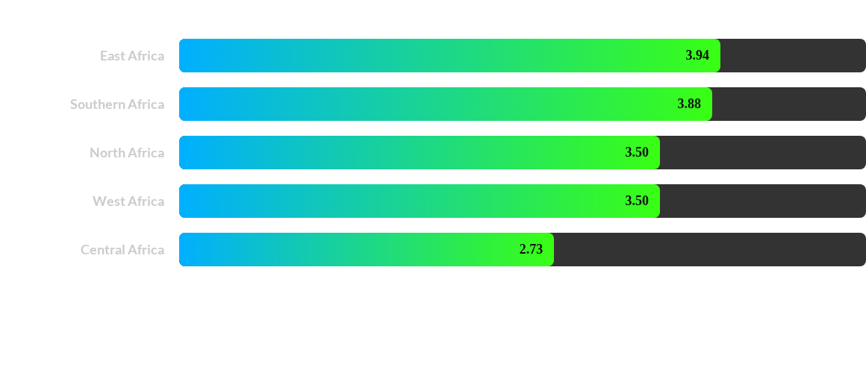
Cyber-Dependent Crime Scores (Average by Region)
Scores from the 2025 Index highlight varying levels of cyber-dependent crime, with East and Southern Africa showing the highest regional averages.

Slide 8
Recent Case Studies (2023-2025)
Highlighting major cyberattacks across the continent

Slide 9


Case Studies: Central & East Africa
Central Africa
East Africa
Cameroon (2024): Cyberattack on Eneo, the national energy provider, disrupted applications.
Kenya (2024): Hack on Micro & Small Enterprises Authority exposed sensitive data (employee records, financials) on the dark web.
Gabon (2023): Bianlian ransomware group targeted BGFIBank Group, stealing sensitive commercial data and disrupting services.
Sudan (2024): 'Anonymous Sudan' DDoS attacks on Egypt's mobile operators caused hours of outages.
Uganda (2024): Offshore hackers targeted Bank of Uganda, illegally transferring approx. US$16.8 million.

Slide 10


Case Studies: North & Southern Africa
North Africa
Southern Africa
Egypt (2024): FunkSec group breached Egyptair, gaining access to admin portals. Access was listed for sale on a dark web platform.
Namibia (2024): Ransomware attack on Telecom Namibia leaked data of ministries, senior officials, and clients, exposing them to identity theft.
Morocco (2025): An unprecedented cyberattack on social security services resulted in the leakage of sensitive data on millions of citizens.
South Africa (2024): Ransomware attack on the National Health Laboratory Service severely disrupted the public health system and put patient data at risk.

Slide 11


Case Studies: West Africa
Ghana (2024)
Nigeria (2024)
Ransomware attacks against the primary power distributor, the Electricity Company of Ghana, disabled electricity vending capabilities.
The National Bureau of Statistics was attacked, leaving its website displaying only a blank page with the message: 'Page hacked'.
The week-long disruption resulted in financial losses estimated at US$34-42 million and affected millions of customers
.

Slide 12
The Path Forward: A Holistic Approach
Strong Legal Frameworks: To ensure unified, harmonized, and enforceable laws across the continent.
Improved Technical Capacities: To close the tool and skill gap between law enforcement and cybercriminals.
Regulatory Reform: New regulations must be grounded in human rights principles with robust oversight.
Fundamental Strategy: Cybersecurity must become a core component of development, not just a reactive policy.

Slide 13
The danger of being a visionary
… The danger is that you will be misunderstood.
… They’ll question you. Or discourage you. Or even laugh at you.
… Continue. At all costs.
… longs for a brighter future in the age of deep change.
Thank you for your attention.

